Slide 1
Cross Enterprise TeleHomeMonitoring Workflow Definition
(XTHM-WD)
Detailed Profile Proposal for PCC 2012/2013 Cycle
presented to the PCC Technical Committee
Claudio Saccavini, Silvia Mancin, Valentina Ferrarini, Luca Zalunardo, Arianna Cocchiglia
November, 15th 2011

Slide 2
Effort Estimates
The work effort for profiling the XTHM-WD has been estimated high.
The work requested to PCC is:
Definition of the clinical process in the context of a telemonitoring service (effort estimate high)
Definition of a common structure of a workflow definition profile (effort estimate medium)
Definition of a common language to define a workflow definition profile. The world of definition profiles could need the use of specific words from workflow management world. There will be the necessity to analyze the common understanding of the language by the IHE users (effort estimate medium/high)
Definition of the clinical document including the data generated by personal healthcare monitoring devices (effort estimate medium)
Definition of specific actors involved in the process: each actor involved can act as XDW actors but to define the telemonitoring process there is the need to specify the actors with their related role in the process (effort estimate medium)

Slide 3
XTHM-WD Profile: Agenda
Summary
The Problem
Use Case
Standards & Systems
Technical Approach
Risks
Open Issues
Effort Estimates

Slide 4
XTHM-WD Profile: 1. Summary
Summary
The Problem
Use Case
Standards & Systems
Technical Approach
Risks
Open Issues
Effort Estimates

Slide 5
XTHM-WD Profile: 1. Summary
Problem
  The management of chronic patients followed by telemonitoring services is difficult to be performed from every actor involved in the process: at the moment there aren’t instruments to manage and share the complete clinical history of the patient, from the monitored data to the events incurring during the process
Solution
  XDW profile can provide the structure to build a cross-enterprise workflow where each event and the related status and documents are tracked and shared between each actor involved

Slide 6
XTHM-WD Profile: 1. Summary
Main goal
  Specific application of the XDW profile in the context of a telemonitoring process, defining the rules to create and to manage a cross-enterprise workflow including the complete clinical history of a telemonitored patient
Perspectives
  The introduction in clinical practice of a telemonitoring service, with a good management of the workflow, is increasingly important because of the growing of the number of people suffering of chronic diseases that need to be continuous monitored
  It has been shown that adopting telemonitoring services would so entail a considerable advantage in terms of quality of life for patients and cost savings

Slide 7
XTHM-WD Profile: 2. The Problem
Summary
The Problem
Use Case
Standards & Systems
Technical Approach
Risks
Open Issues
Effort Estimates

Slide 8
XTHM-WD Profile: 2. The Problem
Current situation:
  At the moment, the management of the workflow inside the single enterprise, related to the remote data transmission from point-of-care device, is already included in the DEC Profile of PCD Domain
  In the case of the management of patients with chronic diseases followed by a telemonitoring service, where many actors are involved in the process (hospital’s specialists, General Practitioner, Tele-homecare Center’s staff) and each of them manages his part of the telemonitoring workflow, there is the need to manage a cross-enterprise workflow

Slide 9
XTHM-WD Profile: 2. The Problem
XTHM-WD Profile:
  Makes feasible to manage the cross-enterprise workflow of a telemonitoring process by using the XDW profile, allowing every actor to share the complete telemonitoring workflow, including:
    All events incurring during the process (data sending, request for a visit, change of therapy)
    Related documents
    Status of each event

Slide 10
XTHM-WD Profile: 3. Use Case
Summary
The Problem
Use Case
Standards & Systems
Technical Approach
Risks
Open Issues
Effort Estimates

Slide 11
XTHM-WD Profile: 3. Use Case/ 1st Part
The General Practitioner (GP) requests for a Tele-homecare monitoring service to the Tele-homecare Center for his patient with chronic heart failure, creating the Telemonitoring Workflow Document (TWD) with references to the reports of the exams and to a formal request for service activation
The patient collects his clinical parameters at home and sends these data daily to the Tele-homecare Center.
The Tele-homecare Center transmits the data received to the GP’s Electronic Health Record and includes them in the Telemonitoring Results Document (TRD) referenced in the TWD.
This process is repeated for every data transmission so the TWD is continuous updated and tracks all events and their respective status along with the associated documents.

Slide 12

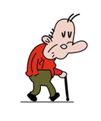
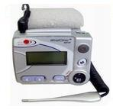
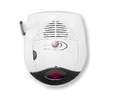

XTHM-WD Profile: 3. Use Case/ 1st Part
GP
Content Creator/
Content Consumer/
Device Obs. Consumer
Tele-homecare Center
Content Creator/
Content Consumer/
Device Obs. Reporter/
Device Obs. Consumer
Patient home
Biomedical devices
Gateway
Device Obs Reporter
[PCD-01]
Communicate PCD Data
System for data storage and management
EHR
[PCD-01]
Communicate PCD Data
[ITI-43]
Retrieve Doc Set
[ITI-41] Provide&Register
Doc Set-b (TWD)
[ITI-41]
Provide&Register Doc Set-b (TWD + TRD)
Repository
Telemonitoring data collection
Repository
[ITI-43]
Retrieve Doc Set
Hospital’s Specialist
Content Creator/
Content Consumer/
[ITI-42]
Register Doc Set-b
2nd Phase: periodic data transmission process
[ITI-18]
Registry Stored Query
1st Phase:
TWD Creation
EHR
Community
Infrastructure
[ITI-42]
Register Doc Set-b
Registry
[ITI-18]
Registry Stored Query
Repository

Slide 13
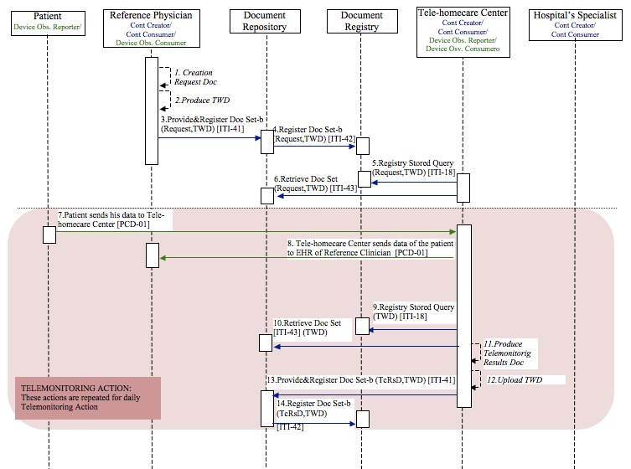
XTHM-WD Profile: 3. Use Case/ 1st Part

Slide 14
XTHM-WD Profile: 3. Use Case/ 2nd Part
In the case that the data sent by the patient go out the threshold, the Tele-homecare Center alerts the reference physician (GP), creating a Request Consult Document (RCD) referenced in TWD, that analyzes the data of the patient and if he decides that patient needs to have a specialist visit, creates the eReferral Document, referenced in the same Workflow Document, for the visit order.
When the visit takes place, the specialist, may consult the Workflow Document to have the complete clinical history of the telemonitored patient and he can update it based on the visit outcomes.

Slide 15
XTHM-WD Profile: 3. Use Case/ 2nd Part
GP
Content Creator/
Content Consumer/
Device Obs. Consumer
Tele-homecare Center
Content Creator/
Content Consumer/
Device Obs. Reporter/
Device Obs. Consumer
Patient home
Biomedical devices
Gateway
Device Obs Reporter
[PCD-01]
Communicate PCD Data
System for data storage and management
EHR
[ITI-41]
Provide&Register Doc Set-b
(TWD + TRD + RCD)
[ITI-41] Provide&Register
Doc Set-b
(TWD + eReferral Doc)
Telemonitoring data collection
[PCD-01]
Communicate PCD Data
Repository
Repository
[ITI-43]
Retrieve Doc Set
Hospital’s Specialist
Content Creator/
Content Consumer/
[ITI-43]
Retrieve Doc Set
[ITI-42]
Register Doc Set-b
[ITI-18]
Registry Stored Query
EHR
Community
Infrastructure
Legend:
TWD: Telemonitoring Workflow Document
TRD: Telemonitoring Results Document
RCD: Request Consult Document
Registry
[ITI-41] Provide&Register
Doc Set-b
(TWD + Report Doc)
Repository
[ITI-42]
Register Doc Set-b

Slide 16
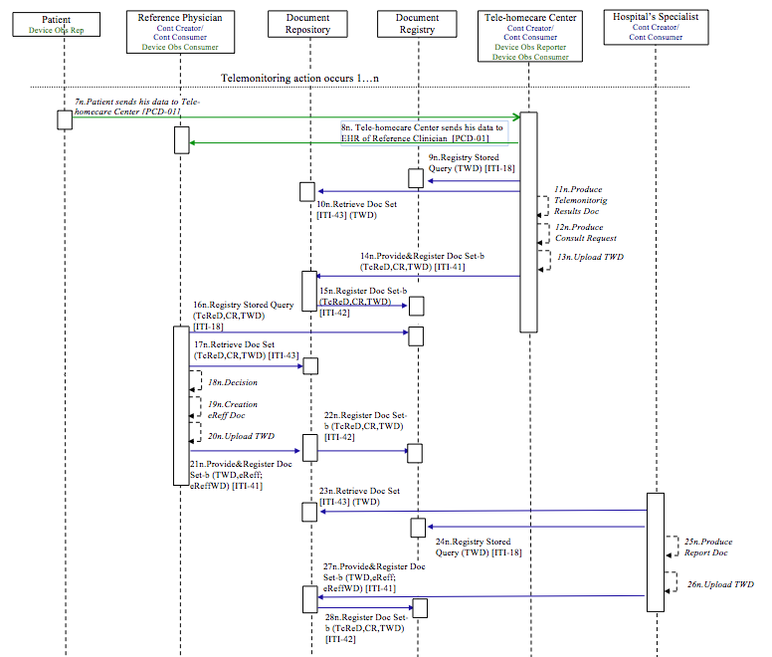
XTHM-WD Profile: 3. Use Case/ 2nd Part

Slide 17
XTHM-WD Profile: 4. Standards & Systems
Summary
The Problem
Use Case
Standards & Systems
Technical Approach
Risks
Open Issues
Effort Estimates

Slide 18
XTHM-WD Profile: 4. Standards & Systems
Afferent IHE Domains: IT Infrastructure, Patient Care Coordination, Patient Care Device
Afferent IHE Profiles – Existing: ITI – XDW, ITI – XDS.b, PCD – DEC (Device Enterprise Communication), PCD – ACM (Alarm Communication Management), PCD – IDCO (Implantable Device Cardiac Observation), PCD – RTM (Rosetta Terminology Mapping)
No XDS Metadata extension expected, but specific rules about metadata content for the Workflow Document

Slide 19
XTHM-WD Profile: 5. Technical Approach
Summary
The Problem
Use Case
Standards & Systems
Technical Approach
Risks
Open Issues
Effort Estimates

Slide 20
XTHM-WD Profile: 5. Technical Approach
Value statement:
  Adopting XDW profile for the management of a telemonitoring process, including all clinical events and tracking their status and their related documents, allowing all actors involved to share and contribute to the same cross-enterprise workflow;
  Define the rules to track the telemonitoring process through the workflow document

Slide 21
XTHM-WD Profile: 5. Technical Approach
  All steps described in the use case and related to the telemonitoring process shall involve the Workflow Document which composition is driven by the set of rules proposed by the Cross Enterprise TeleHomeMonitoring Workflow Definition Profile.
  To create, upload and consult the Workflow Document, every actor involved shall act as:
    Content Creator, Content Updater and Content Consumer
  To send, request and retrieve the Document Workflow from a Registry/Repository Infrastructure every actor involve shall use:
    ITI transaction described in XDS Profile

Slide 22
XTHM-WD Profile: 5. Technical Approach
  XTHM-WD connects three domains, PCC, ITI and PCD, leading a complete management of the telemonitoring process
    PCC domain to define the XTHM-WD profile:
      A clinical process as the telemonitoring deals with the complete management of the patient care and then with many clinical care aspects such as document exchange, order processing, physiological data management and coordination with other specialty domains
    ITI domain (XDW Profile) to structure the telemonitoring cross-enterprise workflow:
      Increase of the consistency of workflow interoperability
      Sharing and updating of all events of the telemonitoring process by the various care areas
    PCD domain to exchange clinical data:
      Standardizing of the data stream, leading the interoperability between different information systems and different actors, using PCD transaction

Slide 23
XTHM-WD Profile: 5. Technical Approach
New actors:
    XTHM-WD does not introduce new actors
Existing actors:
    XDS Document Source, XDS Document Consumer, XDS Document Repository, XDS Document Registry, XDW Content Creator, XDW Content Updater, XDW Content Consumer, DEC Device Observation Reporter, DEC Device Observation Consumer, IDCO Implantable Device Cardiac Reporter, IDCO Implantable Device Cardiac Consumer, ACM Alarm Reporter, ACM Alarm Communicator, ACM Alarm Manager.

Slide 24
XTHM-WD Profile: 5. Technical Approach
New transactions:
    XTHM-WD does not introduce new transactions
Existing transactions:
    From ITI domain: ITI-41, ITI-42, ITI-43, ITI-18
    From PCD domain: PCD-01, PCD-09, PCD-04, PCD-05, PCD-06, PCD-07

Slide 25
XTHM-WD Profile: 5. Technical Approach
    Core activities:
    Definition of the clinical process in the context of a telemonitoring service
      Definition of the sequence of the tasks, task events, etc.
    Definition of a set of rules necessary to manage all the tasks (i.e. who is allowed to change the status of each task, the sequence of the tasks,...)

Slide 26
XTHM-WD Profile: 6. Risks
Summary
The Problem
Use Case
Standards & Systems
Technical Approach
Risks
Open Issues
Effort Estimates

Slide 27
XTHM-WD Profile: 6. Risks
    In real life settings the telemonitoring systems are developed following different projects according to local conditions as existing infrastructure and available technologies
    It could be difficult to reach a sharing, between different realities, of the telemonitoring process defined in this profile proposal
    Complexity in the definition of a Workflow Definition profile related to a telemonitoring process through this profile proposal
    The different domains involved must cooperate to achieve a shared definition of the process
    The telemonitoring process has some specificity in different scenarios which have to be analyzed. A common process has to be defined

Slide 28
XTHM-WD Profile: 7. Open Issues
Summary
The Problem
Use Case
Standards & Systems
Technical Approach
Risks
Open Issues
Effort Estimates

Slide 29
XTHM-WD Profile: 7. Open Issue
  The structure of the device data in a structured clinical document
  XTHM-WD extension in XCA: ITI Technical Committee is working to extend the XDW in XCA multi-community infrastructures.

Slide 30
XTHM-WD Profile: 8. Effort Estimates
Summary
The Problem
Use Case
Standards & Systems
Technical Approach
Risks
Open Issues
Effort Estimates

Slide 31
XTHM-WD Profile: 8. Effort Estimates
  The effort evaluation, estimated high form PCC planning committee, is based on two points:
    The difficulty of structuring a workflow related to a telemonitoring process
    The difficulty to define for the first time a Workflow Definition Profile related to a specific clinical process, since there aren’t previous implementations of this kind of profile

Slide 32
XTHM-WD Profile
Thanks for your attention!
Profile editors:
  Valentina Ferrarini, Arsenàl.IT, vferrarini@consorzioarsenal.it
  Arianna Cocchiglia. Arsenàl.IT, acocchiglia@consorzioarsenal.it
  Luca Zalunardo, Arsenàl.IT, lzalunardo@consorzioarsenal.it
  Silvia Mancin, Arsenàl.IT, smancin@consorzioarsenal.it
  Organization: Arsenal.IT, www.consorzioarsenal.it

